Slide 1
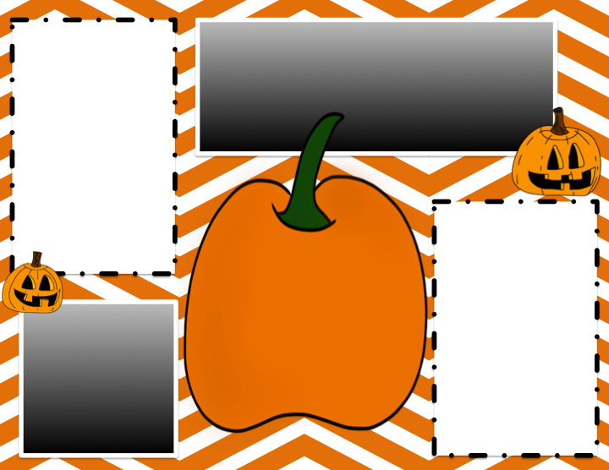
Math News
Launching was a blast! Third and fifth graders are off to a great start writing narratives. We are learning the appropriates parts of each paragraph and strong hooks! Writers cannot wait to celebrate their amazing writing!
We were all excited to start Math Workshop in our classroom. The third graders have been hard at work exploring rounding and elapsed time. Fifth graders have been working with area and volume.
Writer's Workshop
Dates to remember
Reader's Workshop
We launched Reader' s Workshop with a few of our favorite mentor texts. Third grade friends enjoyed using think marks and stopping and jotting while reading. Fifth grade friends compared fiction and nonfiction texts! We are looking forward to building our reading stamina as the year progresses!
October 8 - Half Day
October 9 - Picture Day
October 31 - Halloween Parade
Mrs. Matos
Resource Center
3rd and 5th Grade
October 2018

